Slide 1
Sparse Systems

Slide 2
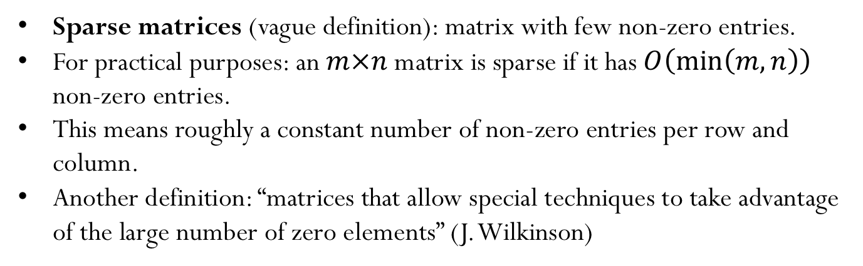
Sparse Matrices
Some type of matrices contain many zeros. Storing all those zero entries is wasteful!
How can we efficiently store large matrices without storing tons of zeros?
Sparse matrices (vague definition): matrix with few non-zero entries.
For practical purposes: an $m×n$matrix is sparse if it has $O\left(\min\left(m,n\right)\right)$ non-zero entries.
This means roughly a constant number of non-zero entries per row and column.
Another definition: “matrices that allow special techniques to take advantage of the large number of zero elements” (J. Wilkinson)

Slide 3
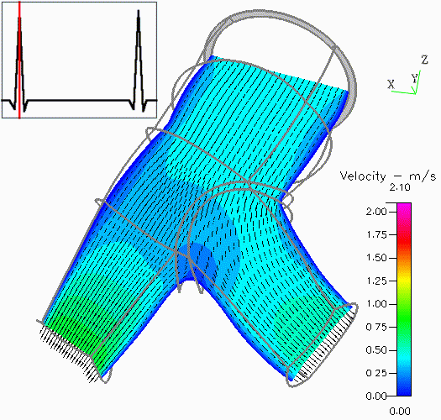
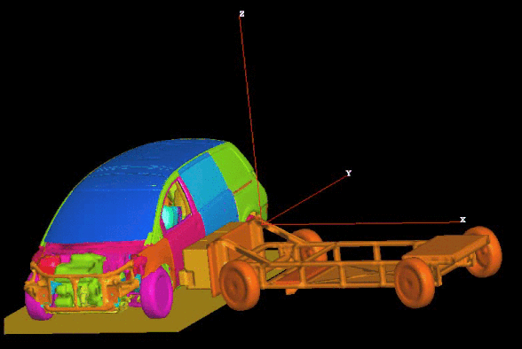
Sparse Matrices: Goals
Perform standard matrix computations economically, i.e., without storing the zeros of the matrix.
For typical Finite Element and Finite Difference matrices, the number of non-zero entries is $O\left(n\right)$

Slide 4
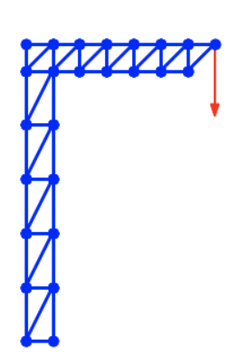
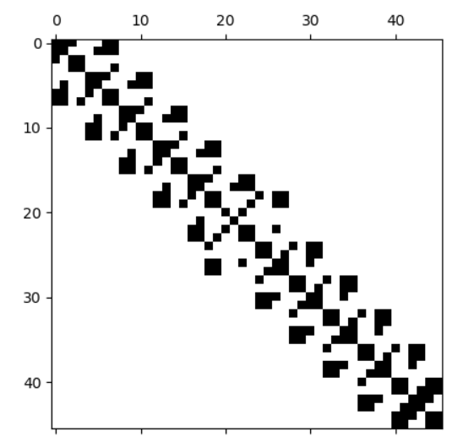
Sparse Matrices: MP example

Slide 5
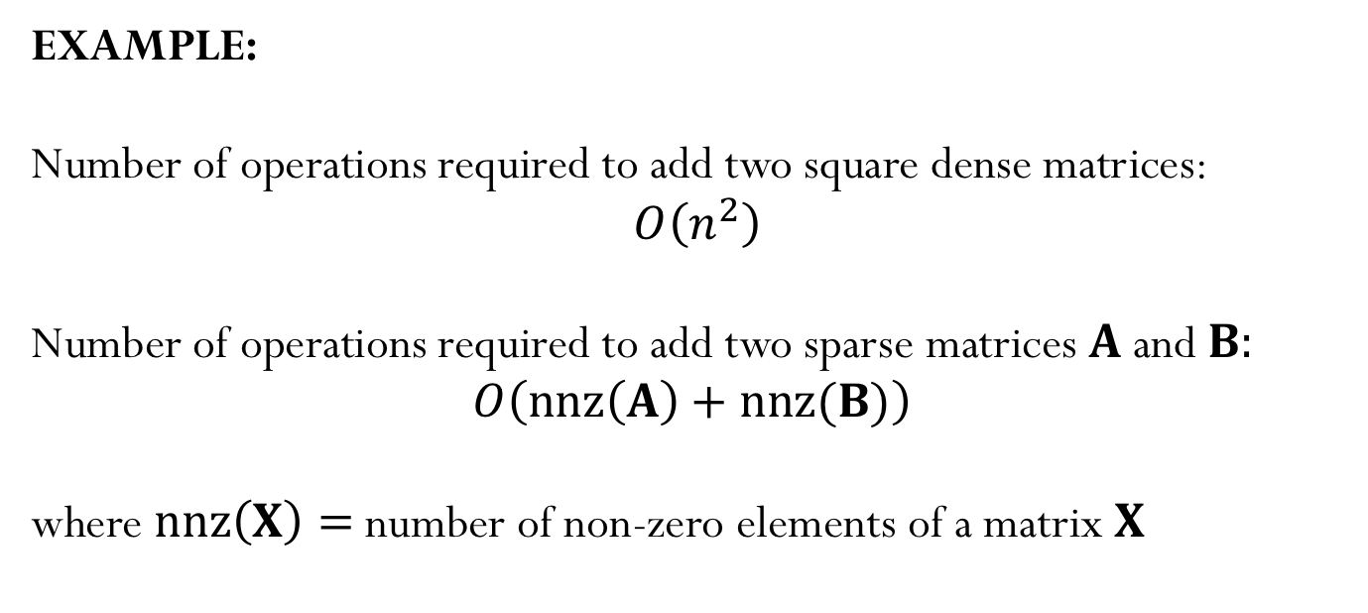
Sparse Matrices
EXAMPLE:
Number of operations required to add two square dense matrices:
$O\left(n^{2}\right)$
Number of operations required to add two sparse matrices $A$and $B:$
$$O\left(nnz\left(A\right)+nnz(B)\right)$$
where $nnz\left(X\right)=$number of non-zero elements of a matrix $X$

Slide 6
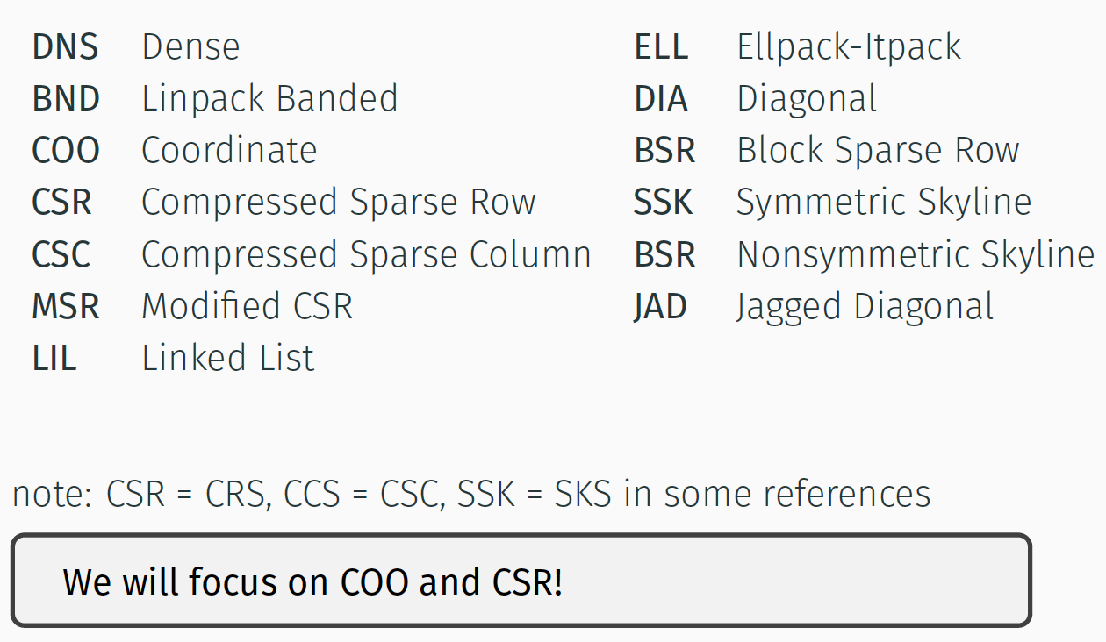
Popular Storage Structures

Slide 7
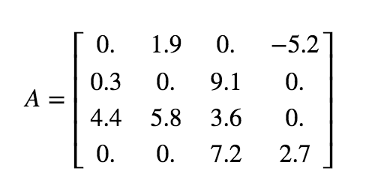
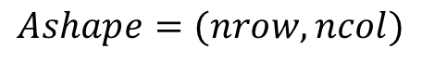
Dense (DNS)
$$Ashape=(nrow,ncol)$$
Row 0
Row 1
Row 2
Row 3
Simple
Row-wise
Easy blocked formats
Stores all the zeros

Slide 8
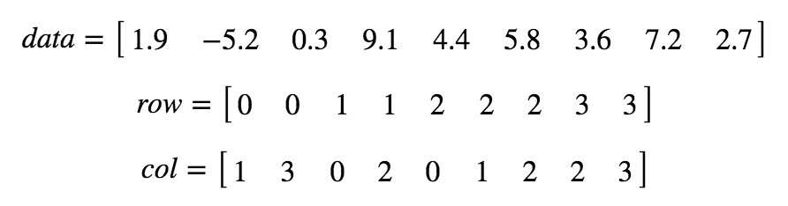
Coordinate (COO)
Simple
Does not store the zero elements
Not sorted
row and col: array of integers
data: array of doubles

Slide 9
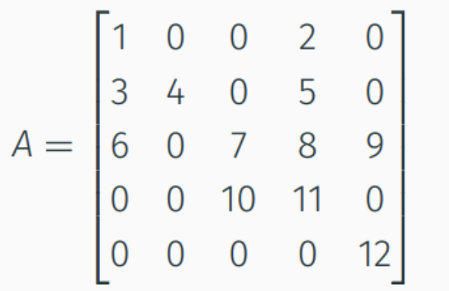
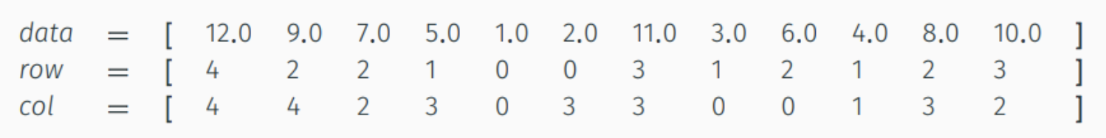
Iclicker question
How many integers are stored in COO format ($A$has dimensions $n×n$)?
A)$nnz$
B) $n$
C) $2 nnz$
D) $n^{2}$
E) $2 n$

Slide 10
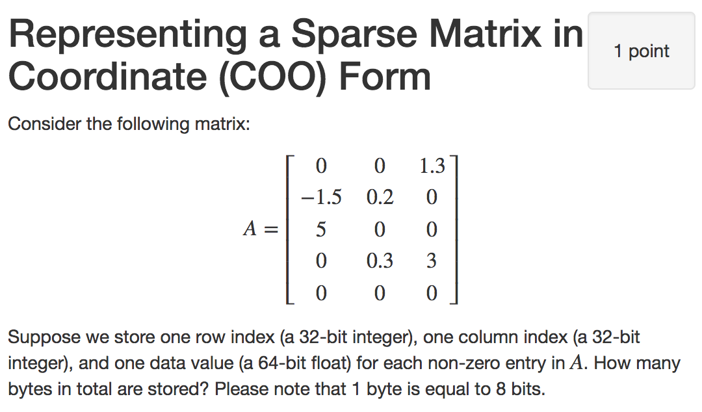
Iclicker question
56 bytes
72 bytes
96 bytes
120 bytes
144 bytes

Slide 11
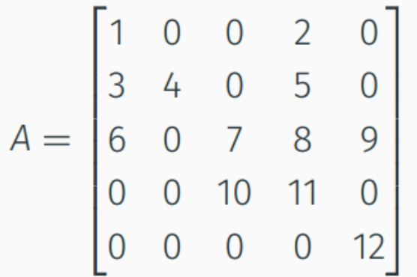
Compressed Sparse Row (CSR)
$$0 1 2 3 4 5 6 7 8 9 10 11$$
Row 0
Row 1
Row 2
Row 3
Row 4
Row offsets
$$nnz(A)$$

Slide 12
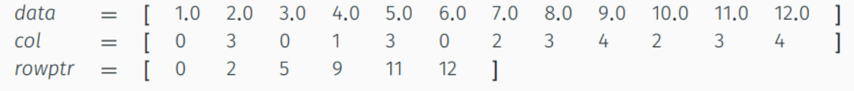
Compressed Sparse Row (CSR)
Does not store the zero elements
Fast arithmetic operations between sparse matrices, and fast matrix-vector product
col: contain the column indices (array of $nnz$integers)
data: contain the non-zero elements (array of $nnz$doubles)
rowptr: contain the row offset (array of $n+1$integers)

Slide 13
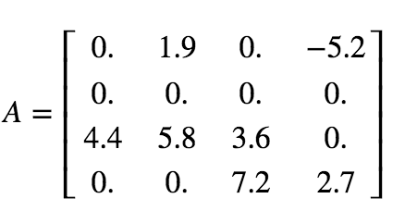
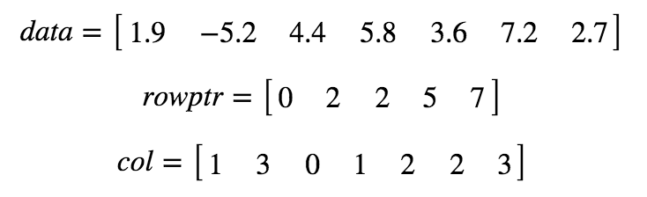
Example - CSR format
Notes:
3

